Slide 1
interdisciplinarity
New approach to studying
Mohammad mahdi Mahmoodzade darbandi | mahmoodzade.com

Slide 2
18TH revolution and then now!
There is more similarities than you can deny between 18th century's industrial revolution and todays AI
then mechanical and physical labor
And now even mental tasks!
In both of this eras we found a great alternative for a big proportion of human
We know that its going to replace a great deal of what we do but we don’t know where to draw the line! There are only two definite items:
1. change is coming
2. about the direct shape of it the only certain thing is uncertainty

Slide 3
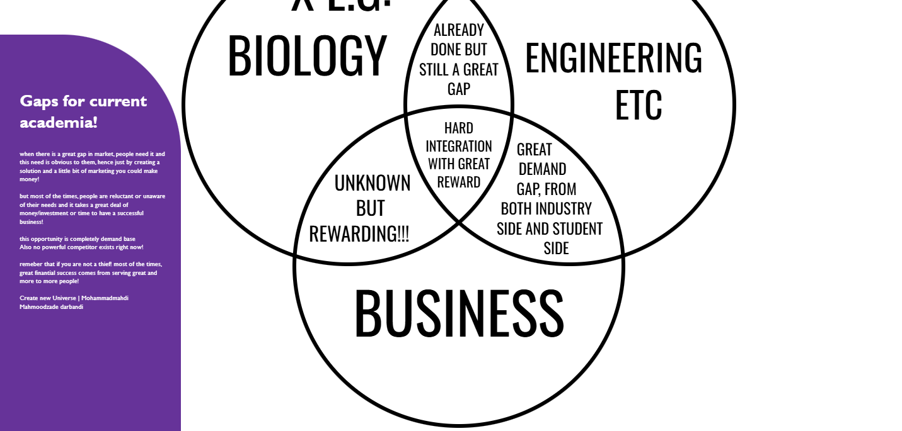
a revolution in education system
Revolution is coming hence we need
Main problems:
This system is not efficient
This system doesn’t fulfill our needs
This system is not designed for new generation (needs like attraction…)
This system is not designed for “shift era”s.

Slide 4
Why should we start from iran?
world
+Special situation of iran
New needs in economy and industry
New generation needs and changes
Need of integration in studies due to changes in science and convergence between branches of science
Bad economy
Concentration of talents in academia *Iranians are both talented and ultra attracted to academia due to different factors and analysis (references available upon request)
Big unanswered gap!

Slide 5
Baby steps of an startup proposal
There is a high potential for the startup im going to discuss in every country. But due to special situation of our country there is a higher chance of success.
2 of 5 options discussed in the given voices

Slide 6
P.S1
P.S2
P.S3

Slide 7
Not exactly the powerpoint guy! But hope it helped!
Mohammadmahdi mahmoodzade darbandi | Create new universe
محمد مهدی محمودزاده دربندی | Mahmoodzade.com

